Slide 1
Understanding GEN AI and machine learning techniques
Jason Chundusu.
Module 5

Slide 2






The ML Pipeline
Collect Data
Prepare Data
Train Model
Gathering raw, unstructured information from various sources to form the foundation of learning.
Cleaning and shaping the data so a machine can understand it, removing inconsistencies.
Feeding the processed data into an algorithm to discover patterns and build predictive capabilities.

Slide 3

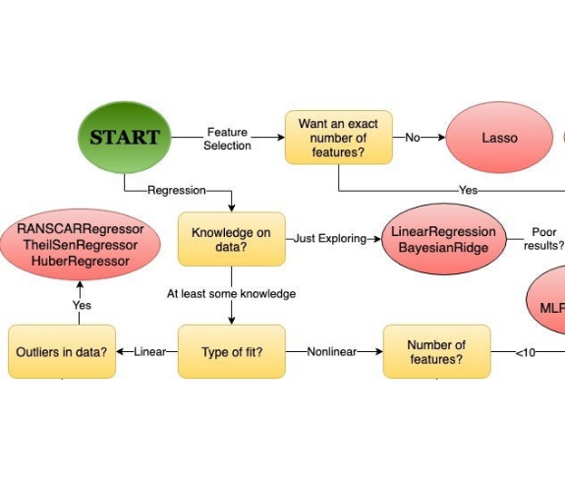
Tools for Classic ML
Pandas: The go-to Python tool for shaping, cleaning, and analyzing datasets.
Scikit-Learn: The essential library for training and testing regression and classification models.
Jupyter / VS Code: The interactive playground for writing and executing ML code in cells.

Slide 4
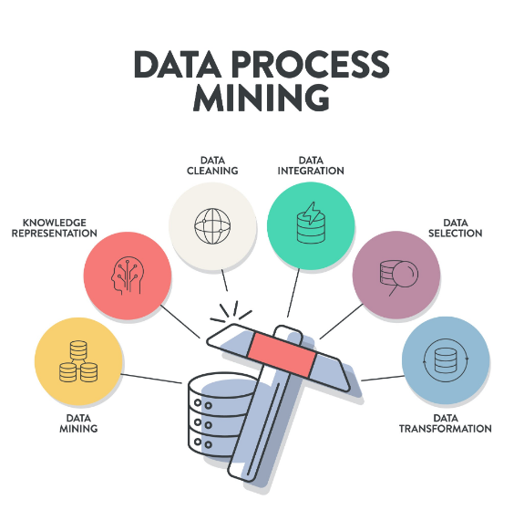
Data Preparation in Practice
Using real-world data, like the USDA pumpkin pricing dataset, requires critical cleaning steps before regression:
Getty Images
Checking for missing, null, or corrupted values.
Standardizing formats (e.g., converting US date strings into extractable month integers).
Filtering the dataset down to only the columns needed for the specific task.

Slide 5


Feature Extraction and Selection
Feature Extraction
Data Selection
Transforming raw data into numerical representations the math can actually process. This involves translating categories, text, or dates into distinct mathematical features.
Choosing the right variables that influence the outcome while discarding irrelevant noise that could confuse the model. Less is often more in classic ML.

Slide 6
A model is only as good as the inputs it learns from. The goal is to generalize patterns, not memorize them.
"
"
— The Overfitting Trap

Slide 7


Deep Networks & Architectures
Discriminative Models
Generative Models
Learn the boundaries between classes to categorize data. They excel at predicting labels, such as determining if an image contains a cat or a dog based on features.
Learn the fundamental characteristics of the data itself to create brand-new, synthetic examples from scratch by understanding the underlying probability distribution.

Slide 8
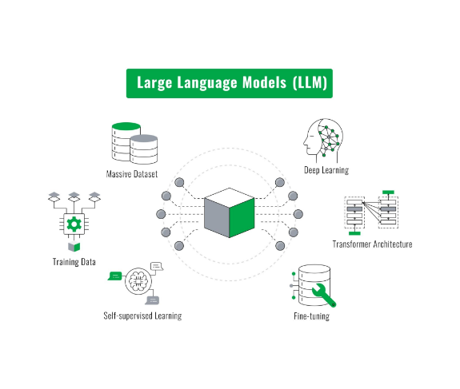
The Generative Frontier
Transformers are the leading architecture behind today's generative AI boom.
Getty Images
How They Work: They use attention mechanisms to understand the context of an entire sequence all at once, allowing them to predict and generate highly coherent text or data.
The Challenge: They require massive amounts of carefully selected data to generate quality output. Understanding how they can sometimes generate hallucinated information is key to safe deployment.

Slide 9
THANK YOU!

